Slide 1

Using OSeMOSYS
This work by OpTIMUS.community is licensed under the Creative Commons Attribution 4.0 International License. To view a copy of this license, visit http://creativecommons.org/licenses/by/4.0/.
Notes:
Presentation, title
Contact info for any issue regarding the course
All access to Canvas and read docs? Please do!!!
Please subscribe to a group – all - asap
If any issue re registration or so, come after lecture / write to me
Do you have any issue with overlapping lectures?
This year’s course will be online:

Slide 2
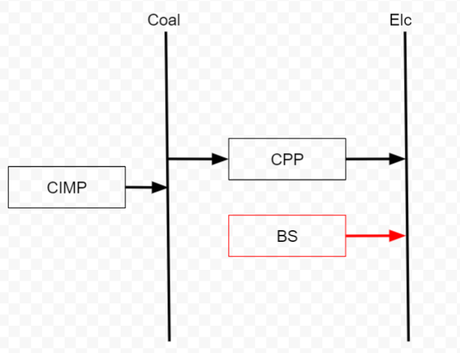
A very simple model to start with
1 simple chain:
1 demand and 1 supply option
The supply must meet the demand
We will work on a txt file, with no interfaces

Slide 3
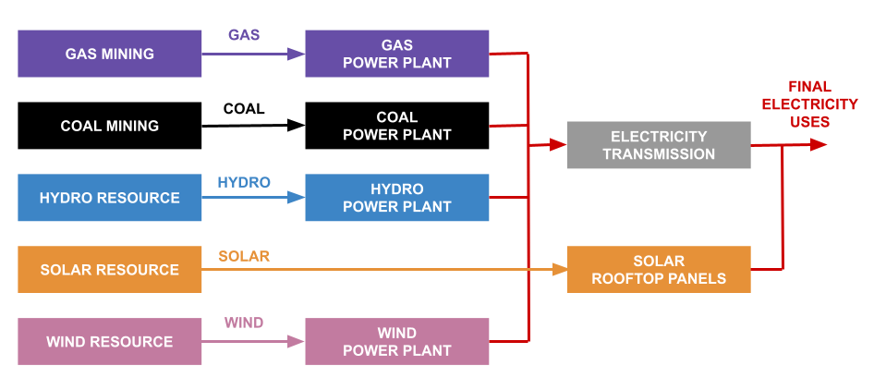
What does a model do?
A simplified representation of reality
Technologies (boxes) and commodities (lines)
This type of model answers:
What technology to invest in
When to invest
How much to invest
How to operate the system
Structure of a simple sample electricity system model

Slide 4
Structure of the model
To create the model, we need the following sets of information:
Technologies
Fuels
Years over which we’ll model
The sub-annual time-slices that will be considered
Hint: ALWAYS sketch out a schematic representation (also called Reference Energy System)
Technology
CIMP – Coal import
CPP – Coal power plant
BS – Backstop
Fuels
Coal – Coal
Elc - Electricity
Year
2020-2030
Fuels
Day & Night

Slide 5
Key concepts: Time and Demand
More energy is normally required during the day, so we assume that:
2/3 of the electricity is used during the day
1/3 of the electricity is used during the night
We split the year equally into Day and Night:
Day takes 50% of the time in one year
Night takes 50% of the time in one year

Slide 6
Key concepts: Time and Demand
More energy is normally required during the day, so we assume that: (Associated parameter: SpecifiedDemandProfile)
2/3 of the electricity is used during the day
1/3 of the electricity is used during the night
We split the year equally into Day and Night: (Associated parameter: YearSplit)
Day takes 50% of the time in one year
Night takes 50% of the time in one year

Slide 7
Key concepts: Technology activity, capacity, input and output
Capacity: installed power (max energy generated per unit of time)
Activity: total actual operation
Output-to-activity ratio: output produced per unit of activity (we assume that 1 unit of electricity is produced for every unit of activity of the power plant**)
Input-to-activity-ratio: input needed per unit of activity. Depends on the efficiency
Capacity-to-activity-ratio: fixed conversion between capacity and activity units. Max energy provided by one unit of capacity in one year. It depends on the chosen units.
Notes:
** we relate, we normalize everything to the output; this because technologies in the power sector are normally characterised with their output. Having a 500 MW power plant installed means having a power plant that can generate 500 MW of electricity (output).

Slide 8
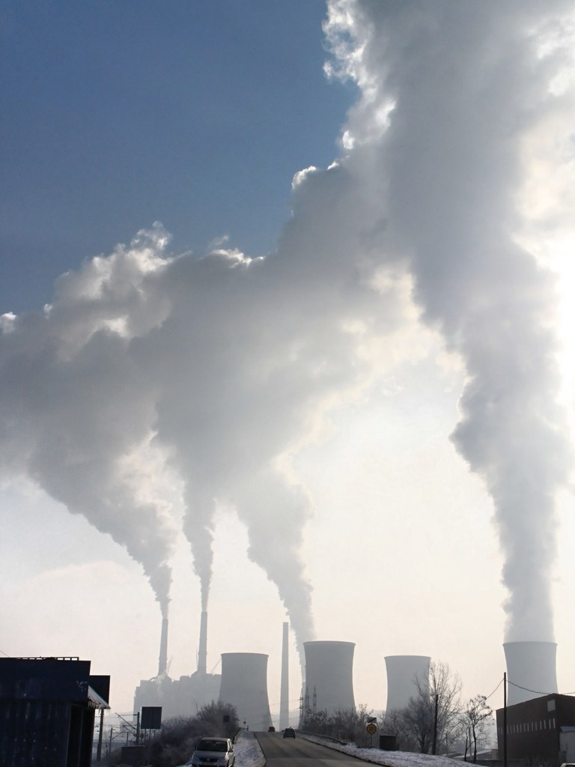
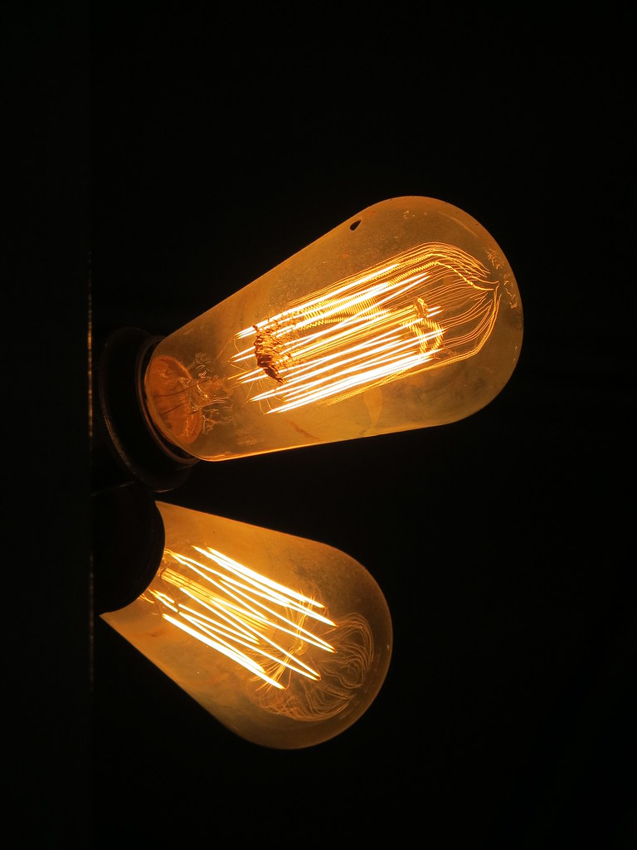
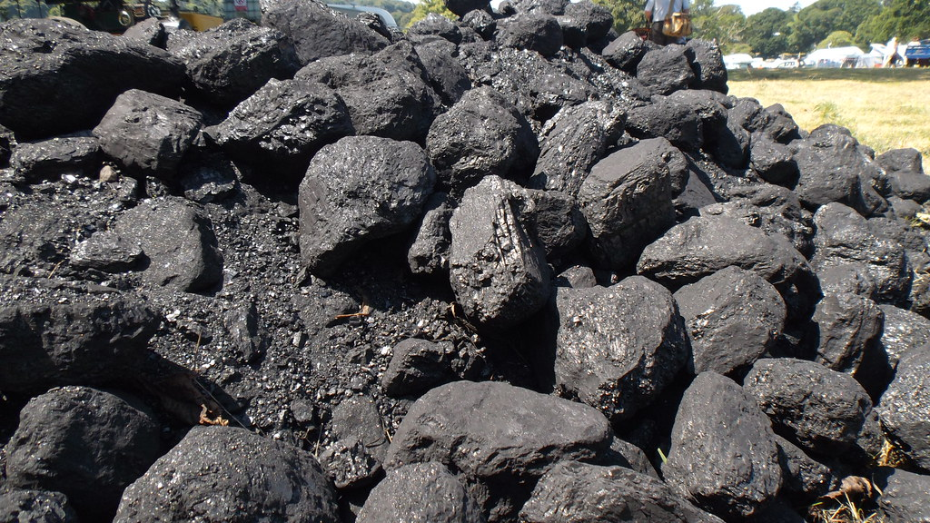
Key concepts: Technology activity, capacity, input and output
ACTIVITY: 3000 GJ of coal in one hour, 6000 GJ in two hours, and so on…
CAPACITY: 1000 GJ electricity per hour
= 1000 GJ / 3600 seconds
= 0.2778 Gigawatts (GW)
CAPACITY: 0.2278 GW
ACTIVITY: 1000 GJ of electricity in one hour, 2000 GJ in two hours, and so on…
Notes:
** we relate, we normalize everything to the output; this because technologies in the power sector are normally characterised with their output. Having a 500 MW power plant installed means having a power plant that can generate 500 MW of electricity (output).

Slide 9
Setting up a model
If you get stuck, check out the user guide and the online forum
Always draw a Reference Energy System scheme
Chose the code required
Put in the Set data
Put in the Parameter data
Check all constraints and ‘default valules’
Start with a demand
Introduce the Backstop
Build the model progressively

